Slide 1
Guardians of the Bays hearing submission presentation
Wellington International Airport Ltd
Designations
20 may 2021

Slide 2
Bridge Street empty sections not in the Main Site designation area

Slide 3
Airbiz graphic of size of Wellington and Auckland

Slide 4
Melrose Hill views into the East Site Area

Slide 5
ExecuJet hanger

Slide 6
1938 Hillock coastal reminant of Lyall Bay

Slide 7
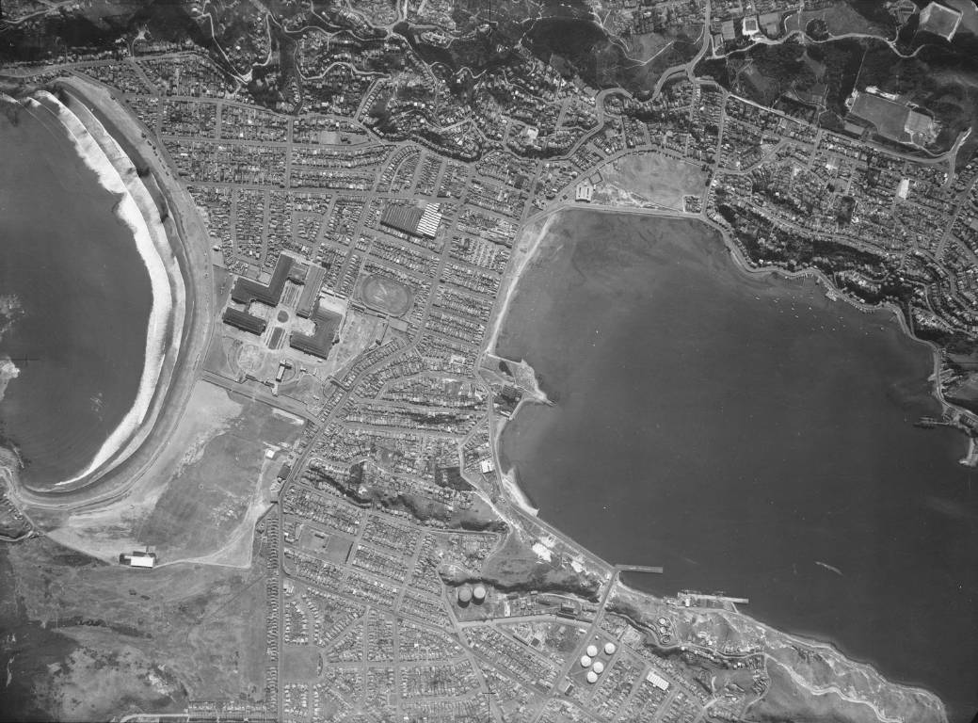
1941 aerial photo of the isthmus pre north south airport

Slide 8
Lyall Bay stormwater pipes from the airport

