Slide 1
Wellington Hockey Association
Facilities Strategy 2014 - 2023

Slide 2
Background
Hockey is one of Sport NZ’s original targeted sports
It is a global sport played by men and women with New Zealand attending the Olympics, Commonwealth Games and World Cups
112 countries play hockey across every continent – with New Zealand currently ranked 5th in the world for the women and 6th for the men
Nationally hockey is seeing strong growth with 4.6% in winter numbers in 2013 and 18% growth in summer participation in New Zealand

Slide 3
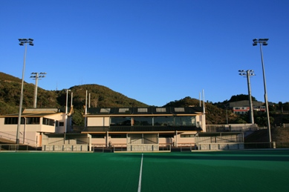
Participation in Wellington Region
Currently 4,390 registered winter players in Wellington Region (10% of national total) and more than 1,200 players over the summer season
Growth in the last 10 years:
13% in open grade
28% in secondary
57% in primary
Summer participation growth of 12% over two years

Slide 4
Barriers to participation
Late playing and practice times
Cost
Open Grade Club Fees average $400 - $500
Lack of sociability
Turf availability (Wellington City)

Slide 5
Impact of turf availability on player numbers

Slide 6
New turf development
Utilisation rates at National Hockey Stadium - 95% in winter
9pm – 10pm slots account for remaining 5%
Currently 1,105 players per turf in Wellington City
Maximum threshold for turfs is 850 people per turf
Wellington City residents frequently have to travel and play out of the city
A third turf in Wellington City is crucial to our growth

Slide 7
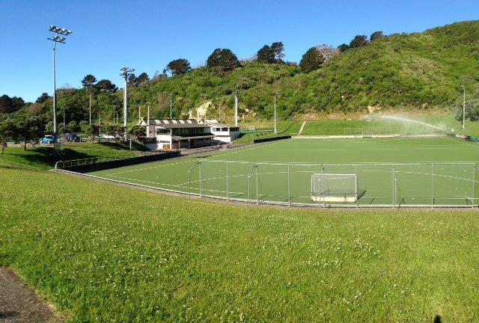
Spectacular Events
Wellington Hockey also wants to bring major events to Wellington
Hockey New Zealand very ambitious with their programme and sees Wellington as a key venue for the country
We have the best ‘bones’ for a hockey facility in the country with the natural amphitheatre surrounding the number 1 pitch
The facility however is 30 year old, and in need of upgrade

Slide 8
Part 1 multi-phase development – 3rd turf

Slide 10
Benefits to Wellington
Increased participation numbers
Increased satisfaction of existing users
Improved sociability of our sport
Large-scale national and international events
Economic benefit
Community pride
Supporting Wellington as a world class events destination

Slide 11
Facilities Management
Until 1 January 2014, all hockey facilities in the region had been managed and operated by the National Hockey Stadium Trust
In order to provide the best player experience, the two organisations agreed to work collaboratively
Under a Management Contract, WHA now operates the four turf facilities in the Wellington Region
National Hockey Stadium, Berhampore
Elsdon Park, Porirua
Fraser Park, Lower Hutt
Maidstone Park, Upper Hutt
The Trust retains a strong asset stewardship role

